Slide 1
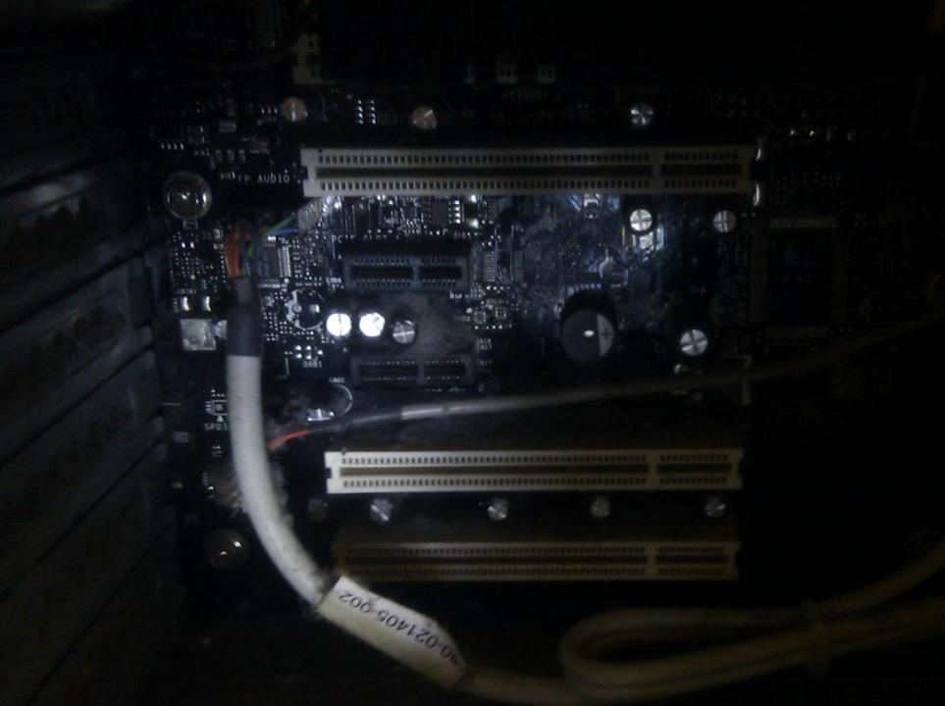

Computing Systems
Lecture 7
Multimedia

Slide 2
Bitmapped Graphics

Slide 3

Notes:
Can see the individual pixels – picture elements – that make up the digital image

Slide 4
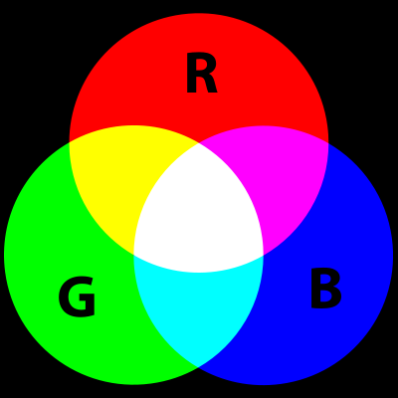
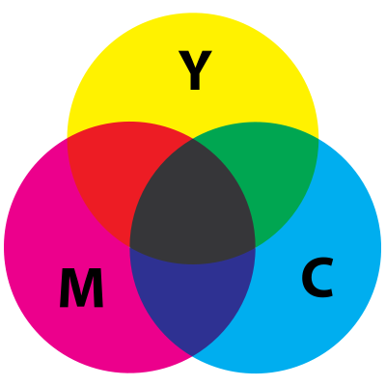
Additive vs. Subtractive Colours
Notes:
Paint and dye are subtractive – the more paints and dyes you combine, the darker the end colour will be.
Computer monitors, lcd screens, televisions etc have additive colours – the more colour you add, the brighter/whiter the end result.
Each pixel can be represented by a 3 byte value: one byte each for the amount of Red, Green and Blue that is present. 3x8bit = 24bits. Sometimes called true-colour.

Slide 5
RGB vs CMYK
RGB
Black = [0,0,0]
White = [255,255,255]
Red = [255,0,0]
Yellow = [255,255,0]
Cyan = [0,255,255]
Pink = [255,145,226]
CMYK
Widely used in printing
Cyan, Magenta, Yellow & Key (Black)
Can be approximated with RGB
High quality printing will use 6 ink colours

Slide 6
Raster Graphics
Raster Scan is a rectangular pattern of colours
  Divided into scan lines. Terms from analog television, now also applied to digital graphics
  Rows and columns of pixels to make complete image
Modern displays built on either LCD or Plasma display technologies
  Wide range of technologies, resolutions, screen sizes

Slide 7
Some Common Screen Sizes
Widescreen Ultra eXtended Graphics Array
WUXGA – 1920x1200
eXtended Graphics Array:
XGA – 1024x768
SVGA – 800x600
Video Graphics Array:
VGA – 640x480 (1987)
HD Television (1080p) has a screen resolution of 1920x1080 pixels.
Notes:
Displaying HD content on a WUXGA display, there are 60 unused lines at top and again at bottom of display – slight letterboxing, but keeping the same image aspect ratio.
There are lots and lots of other display sizes. My current laptop has a resolution of 1366x768 which is one of several resolutions referred to as WXGA (1280x720 to 1366x768)

Slide 8
How much display RAM is required for WUXGA?
For a single 24 bit image
= 3 bytes x 1920 x 1200
= 6.9 million Bytes ~ 6.6MB
Current graphics cards typically have 0.5 – 2 GB of dedicated graphics memory
Notes:
Will see later some of the other ways that graphics cards use memory – and why they need so much more than just needed to store the image that will be output to the screen.

Slide 9
Bitmap Formats
BMP
JPG / JPEG
TIF / TIFF
GIF
PNG
...
Usually uncompressed
Lossy compression
Optional compression
Lossless compression
Lossless compression
Notes:
GIF used to be one of the most common and widely used image formats, but the compression algorithm used was the patented LZW one. When the owners decided to charge license fees to software developers, it quickly fell from popular use. The PNG format was adopted by the W3C (World Wide Web Consortium) as a web standard and is now, along with JPEG and TIFF, one of the most widely used formats.
Most web-browsers support JPEG and PNG formats, as well as SVG (see next!). GIF usually still supported, but not often used other than for short animated images.
Need to discuss lossy vs lossless compression

Slide 10
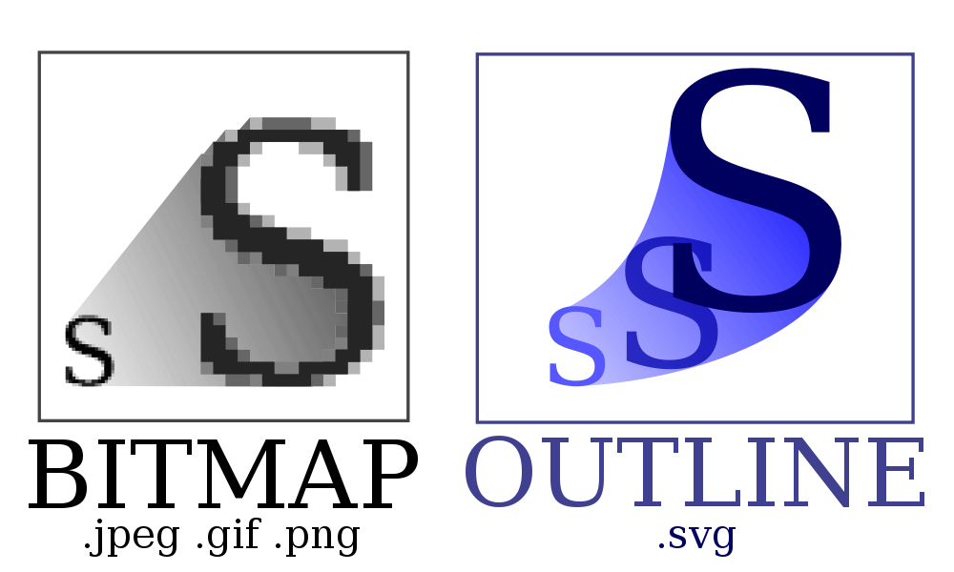
Vector Graphics
Notes:
Vector graphics store instructions on how to draw the image... How to draw lines, curves, do fills etc. The image on right shows a single letter S scaled to different sizes – but based on the same source image.

Slide 11
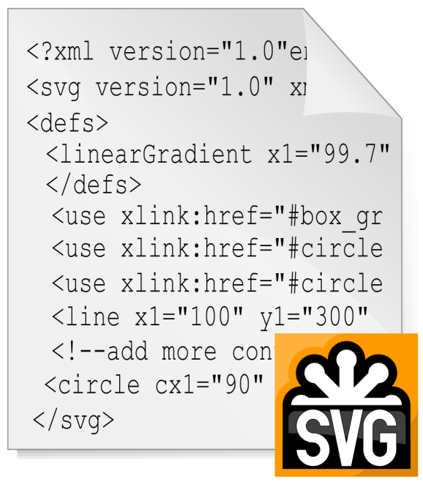
SVG & XML
SVG (scalable vector graphics) is a popular format
Supported by most browsers
Used in Flash
Images defined in XML

Slide 12
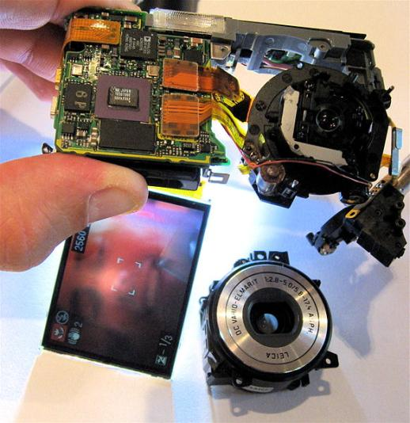
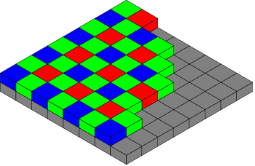
Digital Imaging
CCD or CMOS digital image sensors
  Comparable performance
Filters save RGB data to different pixels
  Software interpolation to create final image

Slide 13
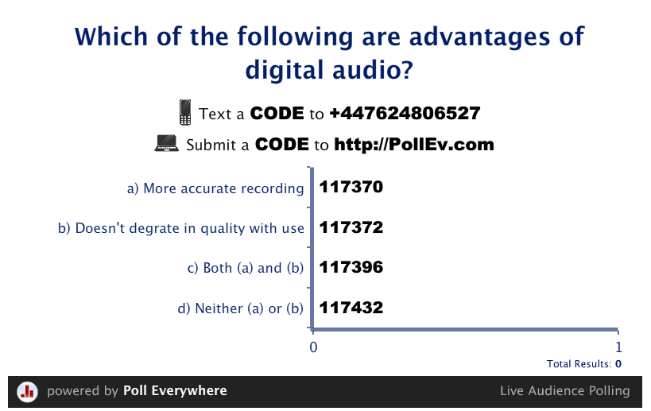
Results

Slide 14
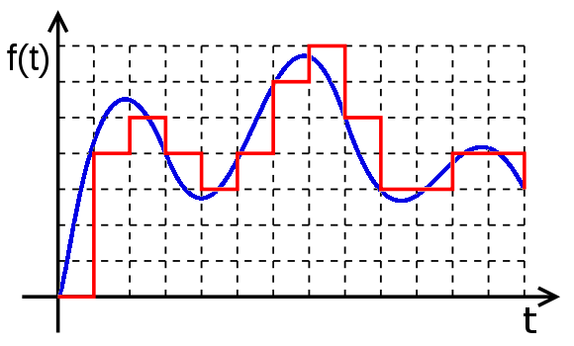
Audio
Sound waves vary in amplitude (size) and frequency
  Human hearing ~ 20Hz to 20,000Hz
Digital audio has use discrete values (red) to represent continuous sound waves (blue):
Quantization
- Digital audio is an
approximation to
the true sound
Notes:
Can also mention that to minimise perceptible errors in quantization, the frequency of the quantization needs to be a little over twice the perceptual range – which is why for music a frequency of 44KHz is common. E.g. Standard CD audio is 44.1KHz

Slide 15
Audio Formats
WAV
MP3
AAC
Vorbis
Windows uncompressed format. OK for short samples (e.g. Sound effects)
Widely used. Supports various bit rates. Lower bitrates result in lower quality & file sizes
Designed as successor to MP3, iTunes/iPod standard format
Open source, patent free compressed audio format
Notes:
MP3 at 128 Kb/s is about 1/10th the file size of standard (uncompressed) CD audio
WAV files are uncompressed – so about the same as CD audio
Vorbis is comparable but patent free. This is important to software and hardware developers as using MP3 or AAC may involve licensing costs.

Slide 16
Video
24 to 60 frames per second (fps)
Succession of still images, appears to observer as smooth motion
  With some odd effects: Wagon wheel effect
If the memory required for a single still image is ~ 256KB, what would be the file size for a 90 minute film at 24fps?
32,400 MB

Slide 17
Key Frames & Compression
Even with compression, it is not feasible to store the complete information for every frame
BUT usually a frame is similar to the previous frame
  Store only the difference from the last frame
  Key frames at scene changes & regular intervals

Slide 18
Containers & Codecs
Container Formats can store different related streams of data in one file – video, audio, captions, meta-data...
Codec is software algorithm for compressing and decompressing audio or video data
  Some container formats have fixed or standard codec, some container formats allow the use of a range of codecs

Slide 19
Video Formats
AVI
WMV
MP4
WebM
Standard Windows container.
Allows user-defined codecs
Another Microsoft format, with optional DRM. Available in Blu-Ray
MPEG-4, based on Apple’s Quicktime. H.264 codec favoured by Apple & Microsoft & available in Blu-Ray
Google sponsored. License free VP8 video and Vorbis audio codecs.
Patent dispute with MPEG group?
Notes:
Video formats can be quite confusing. The three letter filename extension does not always indicate what codec is used – especially for AVI where there is a huge range of codecs available. There are many windows based applications that use their own codecs – which can leave unsuspecting users with AVI videos that they cannot play on other machines, unless they also install the codec first. MP4 & WebM have a limited range of codecs so appropriate players are unlikely to fail.
As a general rule, a MP4 file renamed from xxxx.mp4 to xxxx.mov will usually play without problems in Apple Quicktime.

Slide 20
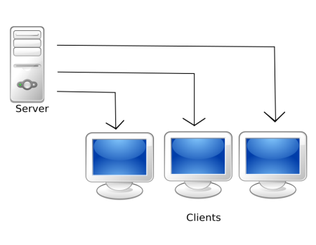
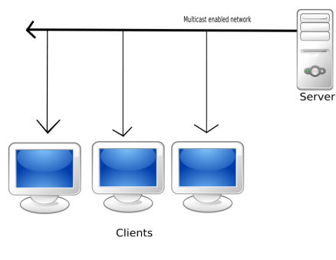
Streaming Audio & Video
Unicast sends different video stream to each client
Multicast sends same video stream to multiple clients
Notes:
Most streaming audio/video uses UDP (User Datagram Protocol) rather than TCP. UDP does not automatically report or retransmit lost packets, though this can be added to the application. In particular, for live streaming, lost packets will result in temporary loss or quality drop of video and/or audio.
Multicast requires specialist server hardware. Clients that cache the media can allow individual users to pause the media, without having to resort to unicast

Slide 21
Media Hardware
Audio signals are analog (continuous) waves
  Quantization requires Analog to Digital Conversion
  Digital to Analog Conversion for reproduction
  ADC and DAC circuits built into audio devices
Audio & video involve processing large quantities of data
  Special Digital Signal Processors (DSP) used so that the CPU doesn’t have to do this
  Designed specifically for high performance on typical media algorithms

Slide 22
Further Reading
Wikipedia:
  Bitmap, Color Space, SVG, Image File Formats, Image Sensor, Digital Audio, Video Compression, Codec, Streaming Media, ...
PCH
  Displays in Chapter 11

Slide 23
Required Reading For Next Week
HCW:
Part 5: Input/Output
  Introduction
  Chapter 14 – How Data Gets Into Your PC
Part 6: Games And Multimedia
  Introduction
  Chapter 22 – Games Hardware
  Chapter 23 – 3D Worlds

Slide 24

This work by Daniel Livingstone at the University of the West of Scotland is licensed under the Creative Commons Attribution-ShareAlike 3.0 Unported License. To view a copy of this license, visit http://creativecommons.org/licenses/by-sa/3.0/ or send a letter to Creative Commons, 171 Second Street, Suite 300, San Francisco, California, 94105, USA.
Image Credits:
Title Image – CC-BY-SA Daniel Livingstone, 2011
Additive and Subtractive colour diagrams, public domain by Mike Horvath, http://en.wikipedia.org/wiki/Color_space
Bitmap vs Outline graphics – CC-BY-SA Yug, http://en.wikipedia.org/wiki/File:Bitmap_VS_SVG.svg
SVG example – CC-BY-SA Dr. E.F. Tymac, http://en.wikipedia.org/wiki/File:SVG.svg
Disassembled camera - CC-BY Steve Jurveston, http://en.wikipedia.org/wiki/File:Partly_disassembled_Lumix_digital_camera.jpg
Bayer Filter – CC-BY-SA Cburnett, http://en.wikipedia.org/wiki/File:Bayer_pattern_on_sensor.svg
Digital audio sound quantisation, Public Domain by Petr Adamek, http://en.wikipedia.org/wiki/File:Digital.signal.svg
Unicast and Multicast streaming, CC-BY-SA Andrew D White, http://en.wikipedia.org/wiki/Streaming_media
Product names, logos, brands, and other trademarks featured or referred to within the these notes are the property of their respective trademark holders. These notes have been produced without affiliation, sponsorship or endorsement from the trademark holders.

